Slide 1
Introduction to Read Write Inc.
Notes:
Approximately 10 minutes is needed for this session.
Notes are provided to help you lead the presentation.
Notes in italics are for your attention only.

Slide 2
Reading changes everything
Teach a child to read and keep that child reading and we will change everything.
And I mean everything.
Jeanette Winterson
Notes:
Read quote.
Today I want to help you understand more about the Phonics Screening Check – a word reading test that all Year 1s undertake in June.
Accurate word-reading at six is a good predictor of future reading success.
In December 2018, research found that nearly 90% of children who passed the phonics check taken in Year 1 reached or exceeded the expected standard in reading in Year 6.
Reading for pleasure is more important for children's cognitive development than their parents' level of education and is a more powerful factor in life achievement than socio-economic background. (Sullivan and Brown 2013)

Slide 3
What is RWI?
RWI is a rapid Learn to read programme
so children can
Read to Learn for the rest of their lives.
Children learn the 44 phonemes and corresponding graphemes. They learn to blend the sounds to read words – decoding.
RWI uses specially written phonically decodable books for children to talk about what they have read to show they understand – comprehension.

Slide 4
Why choose RWI?
it has been tried and tested over and over again (more than ¼ of English schools are using it)
RWI is systematic, structured and therefore results in rapid teaching and learning of sounds & blending
children read books that are carefully matched to the sounds they know
because of this approach children are successful from the very beginning
it is one of the government’s validated synthetic phonics programmes published April 2021

Slide 5

It all starts with pure sounds …

Slide 6
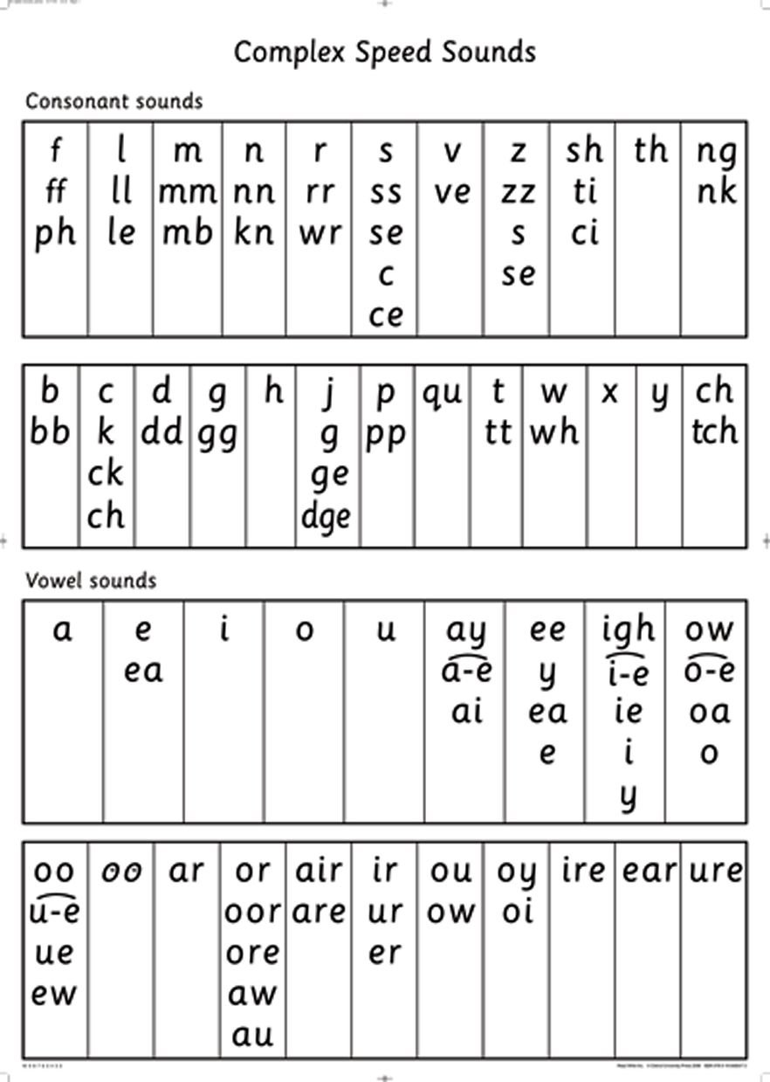
Complex Sound Chart
Stretchy sounds
Bouncy sounds
Bouncy (short)

Slide 7

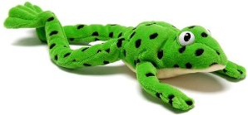
Key Elements to RWI
This is Fred.
Fred can only speak in sounds.
We use ‘Fred Talk’ to sound out words.
We use ‘Fred fingers’ to help us spell words.

Slide 8
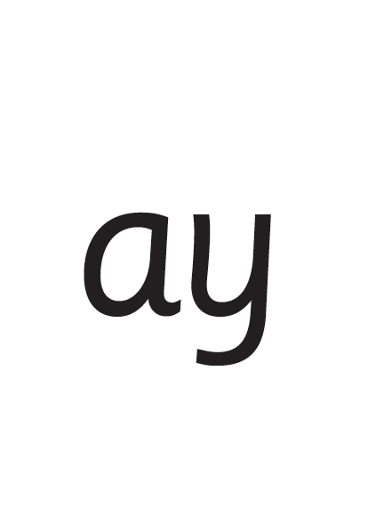
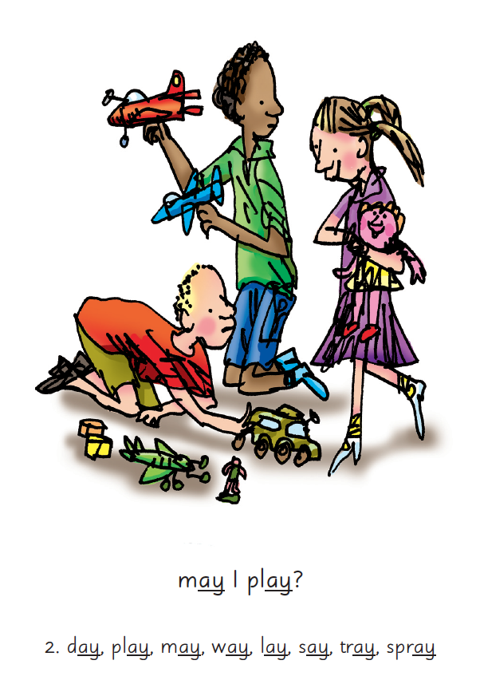

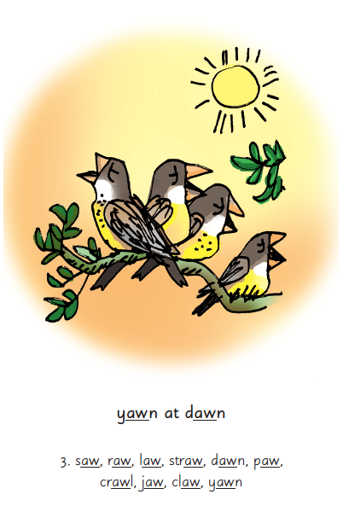
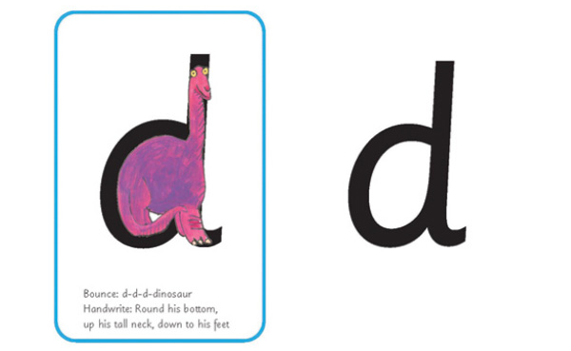
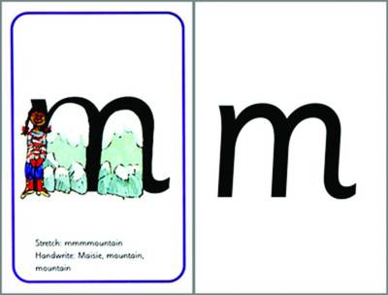
Picture Phrases
Notes:
We teach children sounds using a picture phrases to help them remember.
For example, ay, may I play? aw, yawn at dawn.
Many sounds have two or more letters making one sound. We call these ‘Special Friends’.

Slide 9

‘Special Friends’, ‘Fred Talk’, read the word
Notes:
We teach children to read both real and nonsense words using the routine ‘Special Friends’, ‘Fred Talk’, read the word’.
Children spot the ‘Special Friends’ (two letters that make one sound), Fred talk the word, and then read the word as a whole.
For example, ‘sh’, sh-i-p, ship.

Slide 10



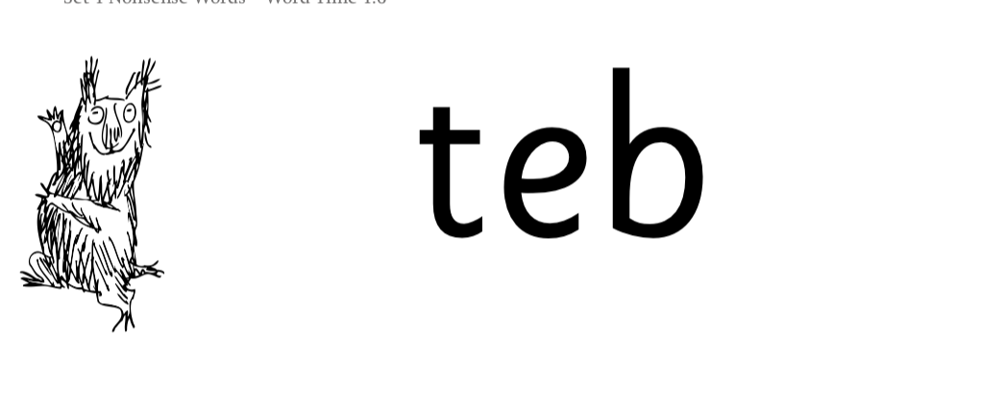
Nonsense words
Notes:
Half of the words in the check are real words.
Half are nonsense words. For example, ‘sheb’, ‘glight’, ‘ched’, ‘teb’.
There is a picture of an alien next to each word to remind the children that it isn’t a real word.
Nonsense words check that children will be able to read sounds they know in unfamiliar words.
Children who can read nonsense words will, very soon, be able to read any new word – for example – gargantuan, flailing, raucous, anticipation;
Reading new words increases children’s vocabulary rapidly.

Slide 11
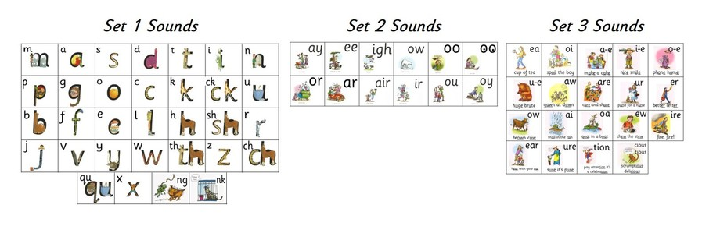
The Graphemes are taught in 3 sets
Set 1: m,a,s,d,t,I,n,p,g,o,c,k,ck,u,b,f,e,l,h,sh,t,j,v,y,w,thz,ch,qu,x,ng,nk
Set 2: ay,ee,igh,ow,oo,oo,or,ar,air,ir,ou,oy
Set 3: ea,oi,a-e,i-e,o-e,u-e,aw,are,ur,er,
ow,ai,oa,ew,ire,ear,ure,tion,tious,cious

Slide 12
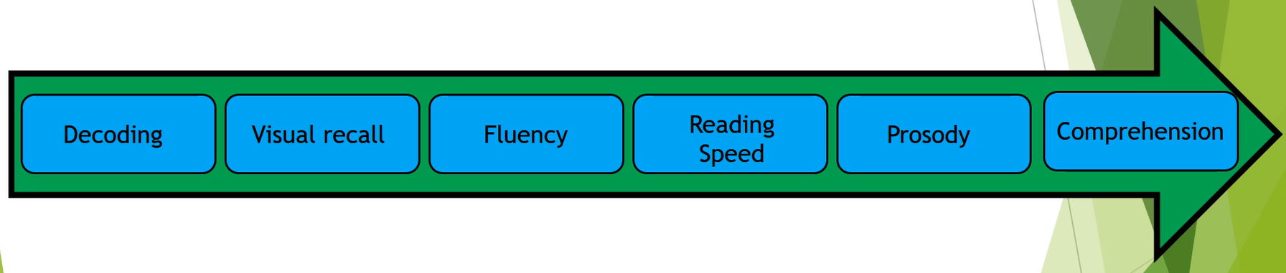
So how do children become ‘good readers’?
High frequency words
Story teller voice / rhythm
Sounding out
Practise
What is going on?
Notes:
We can’t integrate comprehension at the same time as decoding. Working memory only has a finite capacity. Imagine only reading a text one slow word at a time – could you then recall what you had just read. Fluency is crucial from day 1 of learning to read. A reading speed of 90 words per minute is needed for children to comprehend as a they read. Adults read approx. 150 words per minute. Teachers choose reading book bands carefully. If your child is reading a book that is too hard they will not develop fluency. Decoding is not the same as fluency. Rereading familiar texts is hugely beneficial

Slide 13
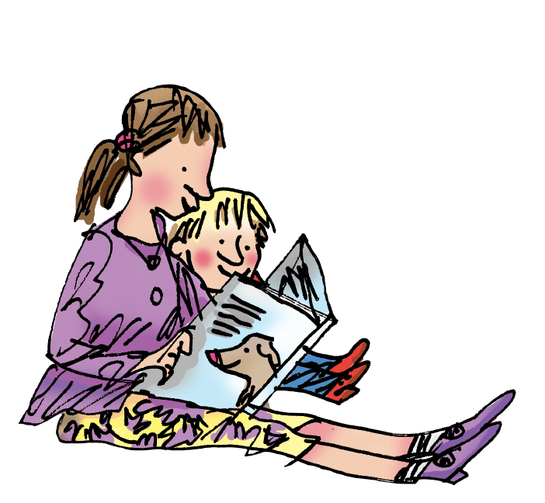
How to help your child at home…

Slide 14
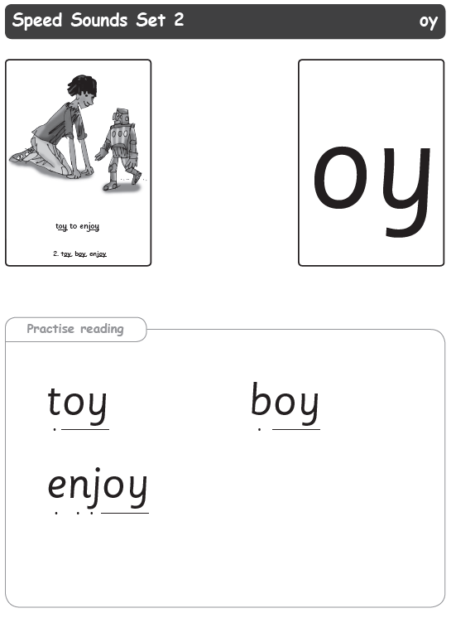
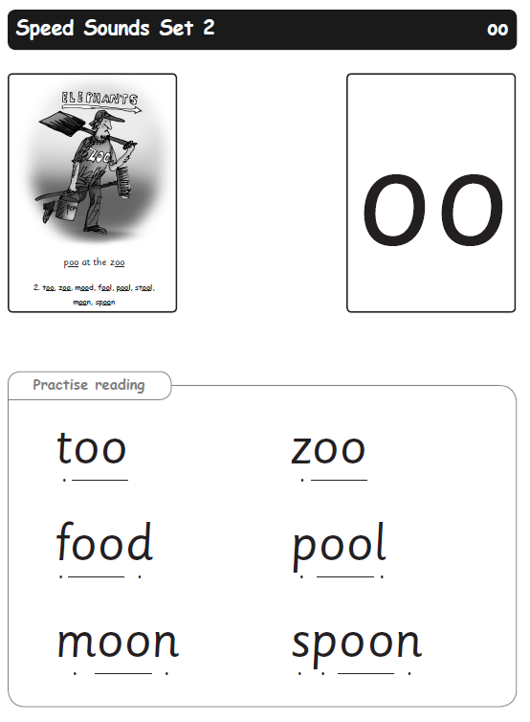
Practise the sounds together ..
Remember no ‘fuh’ and ‘luh’!
Have fun with ‘fred’ talk. “Go and wash your h-a-n-d-s”
Use the speed sound sheets to read and spell together. Keep revisiting.
Prompt your child to ‘fred’ talk new words in their book.

Slide 15
You can read stories with your child. Relentlessly.
What is the character saying?
What is that character thinking?
Listen to them read – a couple of pages is fine. Don’t worry if they have read both of their books, rereading is extremely valuable.
Read their favourite stories to them over and over again.
Read some stories at a higher level than they can read themselves.
A little time every day makes a BIG difference.
How do you
think that character is
feeling now?
What is happening?
What do you think
happens next?
Notes:
View the Ruth Miskin Training suggested reading lists for great books to read with your children.
http://www.ruthmiskintraining.com/teacher-support/tag-44/index.html

Slide 16
Children who read at home do well at school …
Read fluently
Write confidently
Speak articulately
Notes:
“Reading is the one ability, that once set in motion, has the ability to feed itself, grow exponentially and provide a basis from which possibilities are endless.” Michael Morpurgo

Slide 17
Online resources available
Ruth Miskin Parents’ Page:
http://www.ruthmiskin.com/en/parents/
Ruth Miskin Facebook:
https://www.facebook.com/miskin.education
Free e-books for home reading:
http://www.oxfordowl.co.uk/Reading/

Slide 18
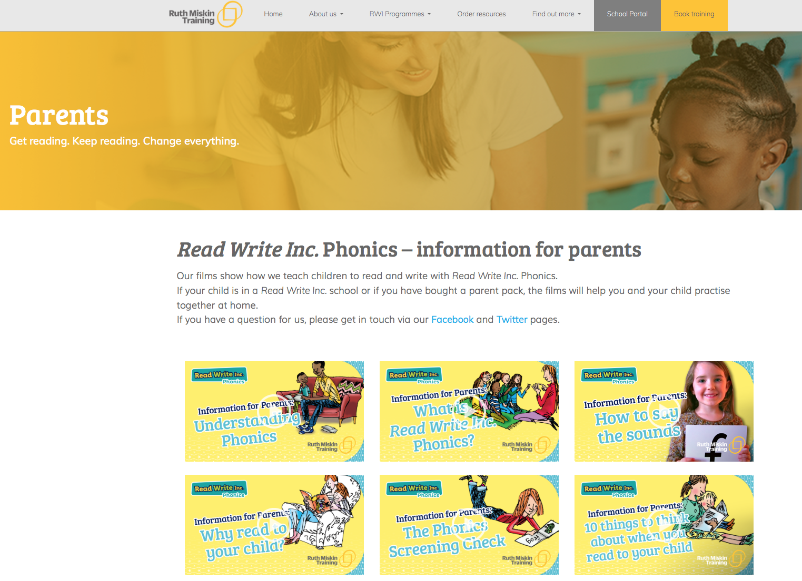
Free Video Tutorials (ruthmiskin.com)
Notes:
Watch these video tutorials on the Ruth Miskin website to find out more about the PSC:
Understanding Phonics
The Phonics Screening Check

Slide 19


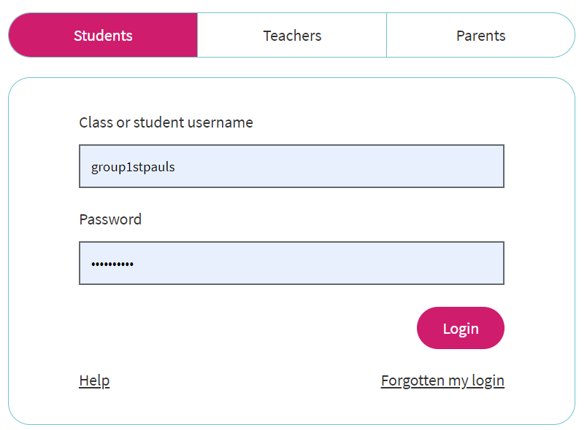
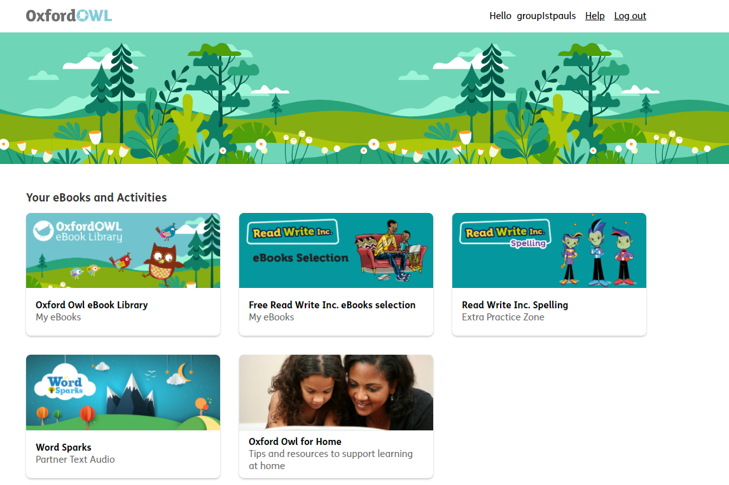
https://www.oxfordowl.co.uk/

Slide 20
Reading changes everything
Teach a child to read and keep that child reading and we will change everything.
And I mean everything.
Jeanette Winterson
Notes:
Remember that all parents have the power to change outcomes for their children.

Slide 21
Any other questions
Q&A

